Slide 1
https://www.merckedsecurity.com/intro-to-hacking-labs

Slide 2
Introduction to Ethical Hacking
Alexander Merck
alexander.merck@duke.edu

Slide 3

Notes:
What is hacking?
Hacking is not a set of routines or procedures. Hacking is a curiosity about how things work. It’s about making a technology do something it wasn’t intended to do.
One physical security example is a lock. A lock has a simple function, which is to prevent unauthorized access to an object or area. However, in order to bypass this lock, you must understand how the lock works…what mechanisms are in place that allow access to those who have permission and deny access to those who don’t.
Finally, when hacking or performing a pentest, it’s always worth stepping back and examining the bigger picture

Slide 4
What makes it ethical?
Permission
In a professional pentest situation, be aware of the risk
Make sure you fully understand how your exploits work before running them against production systems*
ALWAYS practice your exploits in a test environment first
*No good if you crash the system you’re trying to own
Notes:
So what makes hacking ethical? Permission.
This concept is heavily debated, with many philosophical arguments about what ethical hacking means, or whether hacking, by its very nature, can be ethical or not.
However, using the most popular definition of the term, what makes hacking ethical is proper permission to perform tests against a given system.
It is critical to ensure that you have explicit permission prior to any engagement. Along with permission, it is also important to verify that you have a proper understanding of any tool or technique before using it in a production environment, along with any risks associated with a particular test. I recommend testing any hack within a test environment or lab, preferably mirroring the target environment as closely as possible. This way you can properly assess the risk associated with the attack and take any precautions against damaging a production environment.

Slide 5

Take Notes!!!
Take notes on EVERYTHING you attempt, including things that don’t work
Document any scripts or exploit code you develop
Attempt to replicate if possible
Pics or it didn’t happen
Note taking software: Keepnote
Notes:
The first and most important item is to take notes on everything you attempt.
If something is successful, go ahead and document everything up to this point.
Grab screenshots, commands, and terminal output of anything that works.
Even if a command, HTTP request, or exploit is unsuccessful, go ahead and copy this to your notes.
There’s nothing more frustrating than trying to remember what you’ve already trie, even if this command failed.
After successful exploitation, I generally like to attempt a second exploitation, grabbing any additional screenshots or command outputs that may have been missed previously.
Some exploits may only work once, so this may not be feasible.
However, repeatability is always preferred.
Finally, when you gain access to a system or your exploit works, make sure to take a picture.
It may be the only proof you have of successful exploitation.
When presenting your results, if the steps can’t be replicated, “pics or it didn’t happen”.

Slide 6
Kali Linux
https://www.kali.org/
The goto pentesting linux distro
Can run as live CD, as virtual machine, or main OS
Contains most commonly used pentest tools

Slide 7
Setting up a lab
Can run physical hardware
Raspberry pi array
Prefer virtual hosts for testing
VMware – commercial product, free for Duke students
Virtualbox – great in a pinch, fewer features
Other options – Qemu, Hyper-V, etc
Have multiple VMs of the same OS in various patch states
TAKE LOTS OF SNAPSHOTS
Always ensure host is set to “host-only” mode when running vulnerable applications or OSes
Notes:
Before you begin learning pentesting, you need to set up an environment for testing exploits. This can be phyiscal hardware. Some people like to use a series of raspberry pi’s to run their vulnerable applications from. There may be specific reasons for running on particular hardware, such as developing or testing exploits for specific hardware, such as IoT devices.
However, for common tests, I rely on virtualized hosts. Why use Virtual Machines? First, it is extremely quick to build new OSes within a virtual machine. Generally all you need is an ISO of the OS or an OVA file to get a machine up and running. Second, there’s little worry if you completely trash the OS or application when practicing your techniques. You can simply roll back the VM.
There are several virtualization applications that are commonly used.
My preferred application is Vmware, which is a commercial tool, but free to Duke students/staff/and faculty. I generally find Vmware a bit more polished than some other applications, and support for various configurations seems to be better.
Another option is Virtualbox. Virtualbox is now owned and developed by Oracle, but is released as an open source tool. I find performance comparable to Vmware. However, you may run into some issues on some hardware, and it’s generally a little rougher around the edges.
Finally, there are a couple more worth noting. One is Qemu. Qemu can be a bit more involved to get set up and running properly. However, it is great for emulating hardware and alternate architectures. If you’re wanting to work on a exploit for an ARM processor, but only have an Intel machine available, take a look at Qemu.
Finally, there’s Hyper-V, windows’ own virtualization platform. Great if you want to virtualize Windows on a windows machine.
The first thing I’d like to mention about virtual machines is TAKE SNAPSHOTS. Lots of snapshots. I generally like to take an “initial clean state” snapshot whenever I first install an OS. Any time I make a major change, such as installing an application to test, or perform a upgrade, I’ll take a snapshot. That way, if something goes wrong and you end up in a bad state, you can just roll the image back. I’ve found several instances where a device or application ends up in a weird state after running an exploit too many times, and may no longer be exploitable. This is an easy fix with snapshots.
Finally when running vulnerable virtual machines, ensure that your network adapter is set to “host-only” within your virtualzation software. This will ensure that you can only reach the VM from within your own computer.

Slide 8
Metasploitable 2
Metasploitable 2 is a linux distribution which is vulnerable by default
Designed to be a playground for new pentesters
Conveniently packaged in an OVA file for easy deployment
DO NOT ALLOW THIS VM TO BE REACHABLE FROM THE INTERNET. IT WILL BE HACKED
Notes:
The vulnerable virtual machine we’ll be using for this class is Metasploitable 2. This VM is designed with multiple security vulnerabilities built in…it’s a feature! This VM is a great place to test your skills, practice with new applications, etc
When first installing it, make sure you take a snapshot once the OVA is deployed. Like I mentioned earlier, this VM is prone to getting weird after being exploited too many times. Sometimes it’s easier to roll it back to it’s original ”clean” state
Finally, DO NOT run this VM in a way that it can reach the internet or be reachable from the internet. Use host-only mode. I can guarantee that it will be hacked, probably in blinding speed. If we notice a compromised machine on the network, and find out it was a public install of Metasploitable, we will be angry. You will be shamed. You’ve been warned...

Slide 9
LET’S BUILD OUR LAB
Notes:
Ok, we’re now going to build and configure our lab. Hopefully you have the Kali Linux and Metasploitable VM already downloaded.

Slide 10
Scope
First, identify the scope of your test
Black box? Grey box? White box?
Which hosts are you testing?
Which services are you testing?
Which tests are permitted during the engagement?
Notes:
Before beginning a pentest, we must define our scope.
What will we know about the host prior to the engagement? Some tests are white box testing. In these cases, you generally have full access to system configurations, source code, database schemas, full access to system. This is by far the easiest form of pentesting. It’s significantly easier to identify when an exploit is successful or fails and why it may have failed.
The opposite of white box testing is black box testing. In this instance, you know nothing about the system or environment you’re testing prior to the penetration test. All information must be collected or gleaned from recon and scanning. This method is much more difficult, but also quite satisfying when successful.
However, most tests exist somewhere in between, called grey box testing. You may have limited information regarding the host or environment being tested.
Second, what are we testing? A specific application? The entire host? A set of hosts or networks? An entire organization? It’s always important
Finally, always confirm which types of attacks are permitted within the test. In most tests, DoS attacks are frowned upon. They tend to break things, disrupt services, and can be generally unhelpful. However, an organization may want to test their resilience to these types of attacks. Similarly, social engineering or physical attacks may not be in scope for the test. Always make sure to verify before beginning your test.

Slide 11
Recon
Passive
Google
site: *.vulnsite.com finance
Netcraft
Google Dorks:
https://www.exploit-db.com/google-hacking-database/
Shodan:
https://www.shodan.io/
Semi-passive
Normal user behavior
Attempting to access public hosts
Browsing web pages
Notes:
So now that we understand the scope of our pentest, where do we begin? Let’s start gathering information!
Generally the best place to begin during a pentest is to perform passive reconnaisance. This is generally performed by using various sites and search engines. The first step may be to simply enumerate hosts which have been crawled by search engines.
The next step may be to use a google dork to look for a particular vulnerability or valuable piece of information. A Google Dork is a specially crafted google query which searches for particular keywords or pages that may indicate a vulnerable site. Exploit-db.com maintains a fairly comprehensive list of dorks.
Another great resource is Shodan. Shodan is essentially the google for open and/or vulnerable network ports and services. People crawling Shodan have found everything from open web cams, printers, and unprotected nuclear reactor control panels,
Finally, there’s a method which falls somewhere in between passive and active recon. This method is called semi-passive. In this case, the pentester interacts with the host in a way that would be indistinguishable from a normal user, such as browsing web pages or connecting to publicly available services. Even though these methods are more active than using search engines, if performed correctly, these techniques should draw no attention to your activities

Slide 12
Scanning / Vulnerability Detection
Port scanning - noisy
Identify open ports and software versions
Nmap
Vulnerability scanning – very noisy
Nessus
OpenVAS
Web app vulnerability scanning – extremely noisy
Burp Suite
Nikto
w3af
Typically very noisy. Use sparingly, and if stealth is required, slowly
Notes:
Passive recon can only get you so far. You may find an amazing vulnerability or default password using google or Shodan. However, more often than not, you need to dig a bit deeper into the system itself. This is where active recon comes into play. The most common techniques are port / service scanning and vulnerability scanning. There are several tools available to aid in this.
The first method commonly used is port scanning. Port scanning is used to detect any network ports open on a device which may be listening for a connection. Port scanners may also attempt to gather version information using service banners and other methods.
The second method is vulnerability scanning. Vulnerability scanning takes port scanning a step further and tries to actively gather information regarding running services and any vulnerabilities in these services. Can be as simple as grabbing banner information, but may also send probe packets and active tests to better determine if the service is vulnerable. These tools sometimes include rudimentary web application scanners as well.
The final method used in active scanning is web application scanning. These scanners generally send multiple malicious requests to web forms and inspect responses for errors or unusual behavior. These scans are generally extremely noisy and intrusive. If someone is watching on the other end, this is bound to get you noticed.
Finally, there’s manual probing. This method is can be significantly less noisy as the other methods, as you can target specific ports and services, thus resulting in fewer logs and events to notify on. However, this method is slow, and although precise, you may miss something that a scanner would easily detect.

Slide 13
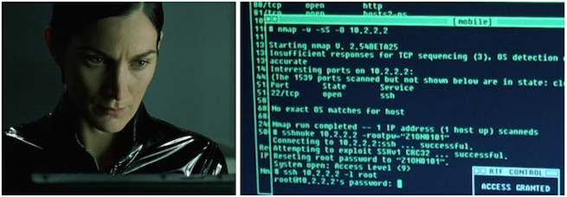
Nmap: What does it do?
Scans for active systems and open network ports
Detects service and application version and banners
Includes a scripting engine (NSE) for active vulnerability scanning
Notes:
AS SEEN ON THE MATRIX AND MR ROBOT! The most commonly used tool for network port scanning, Nmap is a staple in any hacker’s toolbox. At the most basic functionality, Nmap will scan a network for active systems and scan those systems for open network ports. There are several scan methods, such as connection scans, SYN scans, and stealth scans. Essentially, Nmap will send a packet to multiple ports on a system and wait for a response, signifying that a service is listening on the port or not.
Not only can Nmap detect if a port is open, but can present additional information about the service running. It will generally attempt to identify the service running on the port, or at least provide the most common service for that port number. It can also attempt to gather banner information from common services and provide the version number. This information can be very useful for detecting a vulnerable application version.
Finally, Nmap includes a scripting engine, called the NSE. Nmap includes several scripts for detecting service versions and vulnerabilities straight out of the box. It also allows users to write their own detection scripts for Nmap. Some of these scripts can be very taxing on the target system, resulting in performance degradation or denial of service, so always read the documentation for published Nmap scripts before running.

Slide 14
Nmap: Common Flags
-p : specify specific ports to scan
-p- : scan all ports
-p 80,443 : scan common web server ports
-Pn : don’t check for ping response before scanning
-sV : attempt to detect service version information
-O : attempt to detect operating system
Scan types
-sT : TCP connection scan
-sS : TCP SYN stealth scan
-sU : UDP scan
-sF : TCP FIN scan
$ nmap –p 80,443 –Pn –sS 192.168.33.0/24
Notes:
There are several flags most commonly used in Nmap scans.
The first flag presented here is the –p flag. By default, Nmap scans the 1000 most commonly used ports. This can be adjusted by using the –p flag. You can specify a single port, or a list of ports. You can also simply provide a dash after the –p, which will scan all 65535 ports on the system. It is worth noting that scanning all ports (and sometimes even the most common 1000 ports) can be very slow. I generally find it better to look for a very specific set of ports, and then expand the range on particular hosts if I feel it is necessary.
The second flag I commonly use is the –Pn flag. This flag tells Nmap to go ahead and try to scan the IP address even if the host does not appear to be alive. Many times, a host or firewall may be configured to ignore pings. Since Nmap uses pings to identify whether the host is alive before scanning, not using this flag can result in false negatives. Once again, using this flag will increase scan time, so consider whether you feel this is necessary or not when scanning.
The next flags are the -sV and –O flags. These flags tell Nmap to attempt to determine which service versions and operating system the host is running. This information is gathered from port numbers and banner replies. Nmap will observe these responses and make a guess about the system information. It’s generally pretty reliable, but it’s worth noting that it’s still just a guess.
Finally, you can specify the type of scan you wish to perform. I have listed the most commonly used scan types here.
First, you have TCP connection scans. These are specified using the –sT flag, and will attempt a full TCP handshake and establish a connection. This is the default scan method, but is generally slow, and should be avoided if possible.
The second type of scan is a SYN stealth scan. In this scan, the initial SYN packet of the TCP handshake is sent. However, if an SYN/ACK is returned from the scanned host, Nmap then sends RST packet to tear down the connection before it is established. This technique is significantly faster. It also used to be effective at bypassing detection, however modern firewalls and IDSes have no problem detecting these scans
Finally, there is the –sU flag which is used for UDP scanning. Due to the connectionless nature of UDP, scanning UDP is a bit slower and less reliable than TCP scanning. Reliability of results can be increased by using the –sV flag to detect service version.
Let’s run a quick Nmap scan against our host

Slide 15
Nmap: Scripts
Nmap provides a scripting engine called NSE
Several scripts preinstalled on Kali Linux
Found at /usr/share/nmap/scripts
Call scripts using the --script flag
Check details using the --script-help flag
Be aware of risks associated with script
Notes:
Along with being able to scan for open ports, service versions, and OS version information, Nmap includes a repository of useful scripts. It also allows users to craft their own Nmap scripts. Since we found that SMB is open, let’s take a look at what scripts are available for SMB.

Slide 16
NMAP EXERCISE

Slide 17
Gaining Access
Social Engineering
Weak passwords
Poor security configuration
Poor physical security
Malware
Sploits!!!
Notes:
So we’ve identified open ports, running services, and potential vulnerabilities. What are our next steps?
We now need to begin thinking about which angle we want to start tackling the system. This can span several or multiple methods, including social engineering, password cracking / bruteforcing, exploiting poor security configuration on the device itself, poor physical security of the device, malware or browser hooks, and…my personal favorite. Exploits.
Many sucessful compromises will rely on at least one or several of these techniques.

Slide 18
Research
We have a list of services. Now what?
Look for a vulnerability!
Exploit-db
SecurityFocus
Google
cve.mitre.org
Fuzzing / Code Audit / Reverse Engineering
Notes:
Let’s assume our system has several running services, some of which may contain vulnerabilities. After identifying known services, we need to identify any known vulnerabilities for these services.
One common technique is to scour the internet for known vulnerabilities for those services. Common places include exploit-db, securityfocus, CVE sites, such as mitre.org, and sometimes just Googling something like “Awfulwiki, version 2.3 vulnerability”
If no known vulnerability is found, you can always try looking for your own. This includes techniques such as input fuzzing, code audit (if source code is available), or if no source code…reverse engineering.
It’s always worth noting, if you didn’t find anything that looks interesting, go back and look again. If you still find nothing, you’re probably missing something. Look harder. Ask yourself more questions about everything you see. Do you fully understand how everything works and how different components on the system are related? In my experience, almost every failed pentest was due to insufficient recon and research. There have been instances in which writing a report and retesting something resulted in identifying a potential vulnerability. Make sure you look at everything.

Slide 19


Notes:
Also, when performing a pentest, don’t get focused solely on the technology being used. Take a step back and see if there’s another way around. Security is designed by people, and people make mistakes all the time. Make sure you’re not missing something obvious.

Slide 20
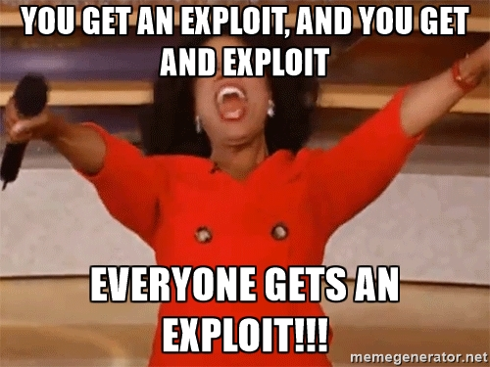
Exploitation
We’ve found a potential vulnerability. Now what?
Metasploit
Exploit scripts
Roll your own exploits
Disclaimer: ALWAYS test your scripts in a lab environment. Be fully aware of what the exploit does before running it in a production environment
Notes:
Now that we’ve found a potential vulnerability, what do we do now? There are several methods to progress from here.
First, we can search for an exploit for the vulnerability in a tool such as Metasploit.
Second, we can search for a published exploit on the web. These scripts may vary from high quality, fully functional exploits to barely or non-functional PoCs…or worse. Most are written in common scripting languages, such as python, perl, or bash, so they’re typically fairly easy to analyze and modify.
Finally, you can develop your own. Sometimes details of a vulnerability or extremely basic Proof of Concept has been published, either only demonstrating a vulnerability, potentially resulting in a denial of service, or targeting an extremely specific target. In this case, it may be viable to do some research and testing within your lab environment and roll your own. Plus, you can give back to the hacking community and become hacker famous! Win-win!
However, there is a disclaimer. ALWAYS test your exploit scripts in a controlled lab environment before running on any production system. Poorly written scripts can have devastating consequences against target hosts, unintentionally crashing machines, deleting or corrupting data, etc. Also, you’re still relying on other hackers for your scripts, who may or may not be the most trustworthy individuals. There are known cases of exploit scripts that target the pentester instead of the target host, either resulting in the pentester compromising their own system or destroying their data. One clever example would delete the person’s root partition and then tweet about it.
Generally, metasploit modules and scripts from exploit-db or securityfocus are relatively reliable, but even then, always test before running in a production environment.

Slide 21

Metasploit Framework
Free and Open source vulnerability resource and exploitation tool
Point and fire exploitation
Includes a Ruby based scripting engine for development of custom modules
Comes preinstalled on Kali Linux
Notes:
For the next example, we’ll use Metasploit to exploit or vulnerable service.
Metasploit is an open source tool developed by HD Moore. This tool is an entire framework supporting vulnerability scanning, exploitation, privilege escalation, and post-exploitation modules. It’s an extremely powerful tool that makes pentesting very efficient.
Not only does metasploit contain pre-written exploits, it also allows you to write your own modules using the Ruby programming language.
The easiness of Metasploit is also one of its downsides. Because of its point and fire nature, it’s easy to throw everything possible at a given service without much thought as to how the exploit works or whether the service is even vulnerable. Using only metasploit without research into what is going on behind the scene will most certainly result in script kiddie status. That being said, it’s an amazing tool, and usually my first stop in a pentest. Why make things harder than they have to be?
Let’s take a look at Metasploit in realtime.

Slide 22
Metasploit Exploits
Metasploit contains repository of exploits
Can be searched with “search <keyword>” command
Ex. > search smb
“info” command provides detailed information on exploit and valid targets
Ex. > info exploit/windows/smb/ms10_061_spoolss
“use” command sets the active exploit for execution
Ex. > use exploit/windows/smb/ms10_061_spoolss
Notes:
Once we launch metasploit framework, we’re presented with an empty command prompt. What do we do next? We look for exploits!
The easiest way to find an exploit is to use the “search” command along with a keyword for the service you’re looking to exploit. For example, if we wanted to exploit SMB, we would type “search smb.”
The search results will return a list of modules which contain the keyword we were searching for, along with a short description, the date the module was released, and the reliability of the module, from average to excellent.
Once we have an exploit that looks interesting, we can find out more information about it by using the “info” command. The info command will provide a short description of the exploit, along with valid targets, configurable options, and references used in the development of the module.
If everything looks good, we can then use the “use” command to set the exploit as active.

Slide 23
Payloads
Must set a payload for execution after exploitation
”search payload” / ”search type:payload platform:windows”
Set payload with “set payload <payload_path>” command
Ex. > set payload payload/windows/meterpreter/reverse_tcp
Can also tab search complete when typing “set payload”
Most common and robust payload is the Meterpreter
Provides shell access
Can run additional metasploit scripts within context
Generally favor Reverse TCP payload
Notes:
We’ve set our exploit. However, exploits aren’t terribly useful without a payload to deliver on execution. A payload is a set of code that will perform an action on the victim host, such as reading or writing a file, creating an interactive shell, or running malware. In order to fully utilize our exploit, we’ll need to configure a valid payload to deliver.
Payloads can be searched for using the search command. Two methods involve search along with the keyword payload. However, if you want to be more granular, you can use search tags and use the search type:payload platform:windows.
Once you have your desired payload chosen, you can set the payload using the “set payload” command, along with the path of the payload module. In this example, we’re setting the payload to the reverse tcp meterpreter payload.
So what is the meterpreter payload? The meterpreter is an interactive metasploit client that is run on the victim’s machine. Within the meterpreter shell, you can run system commands, elevate privileges, dump passwords and/or hashes, run other metasploit modules on the device, and set up interactive remote desktop sessions. It’s an incredibly powerful tool that gives you access to most aspects of the system. Whenever performing a pentest, I generally try to use a meterpreter shell whenever possible due to the sheer number of options provided.
There is a downside to meterpreter, however. Since it is extremely well known and common used by malicious hackers, many antivirus programs easily detect a meterpreter session. Metasploit provides obfuscation and encoding mechanisms for evading AV, but your mileage may vary.
Finally, when setting up shells, if possible, I always opt for reverse TCP shells.

Slide 24
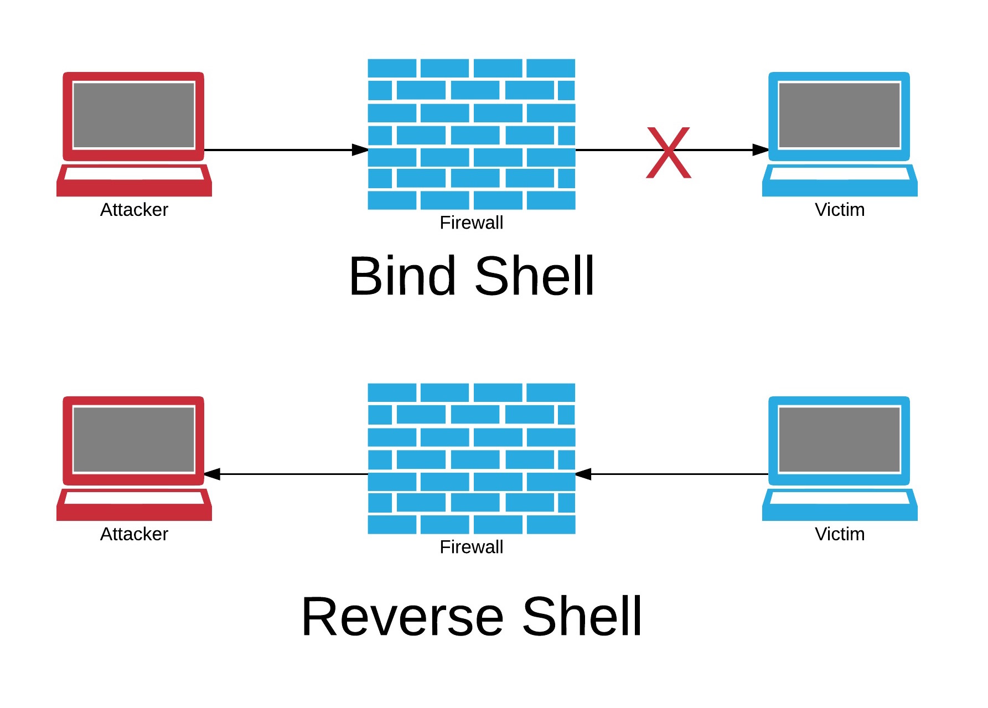
Bind vs Reverse TCP shells
Notes:
So what is the difference between bind and reverse shells? Let’s examine the following graphic.
With a bind shell, a TCP port is opened up on the victim’s machine. The attacker machine then connects to this open port and gains access to the shell. However, if there is a network or host based firewall in place blocking connections to that port, the attacking machine will be unable to connect to the port, rendering the shell useless.
On the other hand, when using a reverse shell, the attacker opens up a port on his attacking machine. After the reverse tcp payload is run on the victim machine, the victim connects back to the open port on the attacker machine, providing the attacker with access to the shell.
Since firewalls are generally configured to block inbound connections to the computer, but not block outbound connections, connect-back shells are generally more reliable and successful. Even if the firewall is blocking most connections outbound, very rarely are they configured to block standard web ports. An easy way around this is to set the connect-back port on your attacking machine to port 80 or 443 (HTTP or HTTPS) and you should make it through the firewall with no trouble.
I estimate about 90% of times I use a connect-back shell. There are very few circumstances when I will choose to use a bind shell over a connect-back shell. One situation may be if I’m pivoting through several machines in a network and proxying this traffic. In this case, it may be a lot faster and simpler to use a bind shell if possible. Another situation may be if I have very little space for my payload in the exploit. Generally, bind shells have a smaller footprint, as the code is less complex. In these cases, a reverse shell may not fit in the payload space, but a bind shell will work just fine.

Slide 25
Options
Must configure options for exploit and payload after selecting
Can view options with “show options” command
Set option with the ”set” command
Ex. > set RHOST 192.168.33.131
Common options
RHOST -> remote (target) host
RPORT -> remote (target) port
LHOST -> local host, IP of your attacking box
LPORT -> local port, port used for the connect-back or bind shell
Notes:
After selecting your exploit and setting the payload, you need to configure the options for your attack.
Each module has its own specific configuration options, such as target host and port.
These options can be listed by using the command “show options.” Many of these options will be configured automatically, but some will require manually setting.
To set an option, use the set command followed by the option name and then the value to set the option variable to. For example, we’ll set the remote host or RHOST option to our IP address.

Slide 26
METASPLOIT EXERCISE

Slide 27
Privilege Escalation
GOT ROOT???
Sometimes already root or SYSTEM
Otherwise, a bit of a dark art
For Windows:
Meterpreter: use priv; getsystem;
look at patch level, any running processes
For Linux:
look at kernel version : uname –a
Look for applications running as root : ps aux | grep root
Metasploit has built in privilege escalation exploits
Notes:
So…we now have access to our system. However, we may have
Sometimes, you get lucky and have root priveleges after exploitation. This is usually the case when exploiting a system level service or application running as root. This is why you shouldn’t run applications as root!
More often than not, however, you are running as a lower privilege user on the system. In this case, you’ll want to find a way to elevate your priveleges, preferrably to root or SYSTEM user.
For Windows, the first thing I always like to try is the getsystem Meterpreter command. It doesn’t always work, but when it does, it works beautifully.
After this, I generally check which OS and service pack
For linux, I first start by checking the kernel version. Many privilege escalation techniques rely on the system running a vulnerability kernel. I usually check this by running uname –a and searching for privilege escalation vulnerabilities for that particular kernel version.
Second, I look at all running processes which are running as root. Often, these services may have vulnerabilities that are not exploitable across a network, but are exploitable once someone has access to the system.
Finally, sometimes you just have to get creative. Look for anything with root permissions. Look for cronjobs that run automatically. Look for any files which may be writable by your current user. I’ve found instances of scripts that are world writable, but then run as the root user. In this case, simply drop your code in the script and wait. Honestly, sometimes it’s better to take the shotgun approach to privilege escalation. It’s generally a bit more finnicky than other methods

Slide 28
Post Exploit: Maintaining Access
Keylogging
Password cracking
Install backdoors
Trojaned applications
Meterpreter : “run persistence”
Create new users
Notes:
So now that we have root on the system, what should we do?
The first order of business is to make sure we can get back into the system if needed. Sometimes services crash or access is terminated unexpectedly. Also, just because you get into a system doesn’t guarantee the exploit will work again. In this case, we want to make sure we can get back in.
There are several techniques we can employ to ensure we maintain access. First, we can install a keylogger onto the system. Metasploit has loadable keyloggers which will take care of most of this work for you.
Second, you can dump password hashes and crack passwords

Slide 29
Post Exploitation: Information Gathering
Dump databases
Read local files
Examine system logs
Dump / crack password hashes

Slide 30
Post Exploitation: Pivoting
Scan internal hosts
Password cracking
Tunneling
SSH Tunneling
ProxyChains
Notes:
So now that you have root on a

Slide 31
PRIVILEGE ESCALATION EXERCISE

Slide 32
Other Resources
Web exploitation
www.owasp.org
Exploit development
corelan.be
Metasploit Unleashed
https://www.offensive-security.com/metasploit-unleashed/
Phrack
www.phrack.org
Conferences
Blackhat
DEFCON
CarolinaCon
Notes:
Find what you enjoy. It’s definitely important to be well rounded, but there are many subdomains in hacking. Find what you enjoy and dive in deep, whether it be exploit development, network exploitation, sql injection, lockpicking, etc.

Slide 33
Where can I practice?
Web hacking
Hackthissite.org
Exploit development
Io.netgarage.org
Overthewire.org
Wargame aggregate and scoreboard
Wechall.net
Bug bounties
hackerone.com - $$$$$
Notes:
There are several sites where you can practice hacking techniques legally.
Finally, look for online forums and IRC channels dedicated to security research and pentesting. Like most things, make sure to put in the work on your end before asking questions, and avoid questions like “How do I hack?” and “Can you hack into this system for me?” To a hacker, this sounds almost as ridiculous as someone approching a medical professional and asking “How do I doctor?”

